Slide 1
Biodiversity in National Parks
A Codecademy Portfolio Project
Veronika Konczné Guld, 2023. április

Slide 2
The Data
Data Science Career Path from Codecademy
Porfolio Project: Data Science Foundations II.
Data: from Codecademy, not real but from reallity inspired
2 databases: species and observations

Slide 3
Species
5824 records in 4 column
category: taxonomy of species.
'Mammal', 'Bird', 'Reptile', 'Amphibian', 'Fish', 'Vascular Plant', 'Nonvascular Plant’
scientific_name: Latin name of species
common_names: common used names of species
conservation_status:
4 values, a big percent of them is NaN.
other values: ‚Species of Concern', 'Endangered', 'Threatened', 'In Recovery’ = that the animal/plant is in kind of danger.
Maybe the data is missing structurally, and means that the conservation status is 'not endangered'

Slide 4
Observations
23296 records in 3 columns:
scientific_name: Latin name of the plant/animal
park_name: locating of the observations
Great Smoky Mountains National Park, Yosemite National Park, Bryce National Park, Yellowstone National Park
obs_num: number of observations

Slide 5
Questions
Main question:
Are there any patterns or themes to the types of species that become endangered? (from Codecademy Task Description)
2 area to investigate
I. relation of category and endangered status
Are there any categories which have bigger probability to be in danger?
II. relation of endangered status and park name
Are there national parks where more endangeredspecies are observed than at other places?

Slide 6
Relation of Category and Endangered Status
how representative are the grades among conservation status?
what are the proportions of categories to each other, which is the most representative category in this data?
how is the proportion of species in somehow endangered status to all species?
is there a connection between categories and being in somehow endangered?

Slide 7
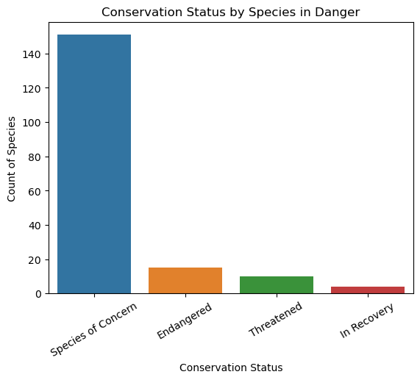
Conservation Status by Species in Danger
all: 180
concerned grade: 151 – 83%
Endangered: 15 – 8.3 %
Threatened: 10
In Recovery: 4

Slide 8
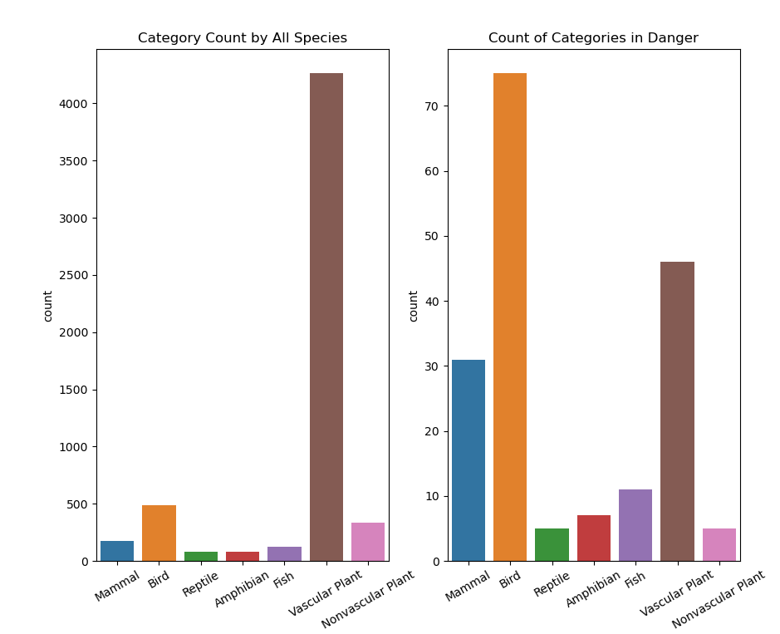
Representation of Categories
All Data:
Vascular plants (4262)
Birds (488)
Nonvascular Plants (333)
Mammal (177)
In Danger:
Birds (79)
Vascular Plants (46)
Mammal (38)
6. Nonvascular Plants (5)
.

Slide 9
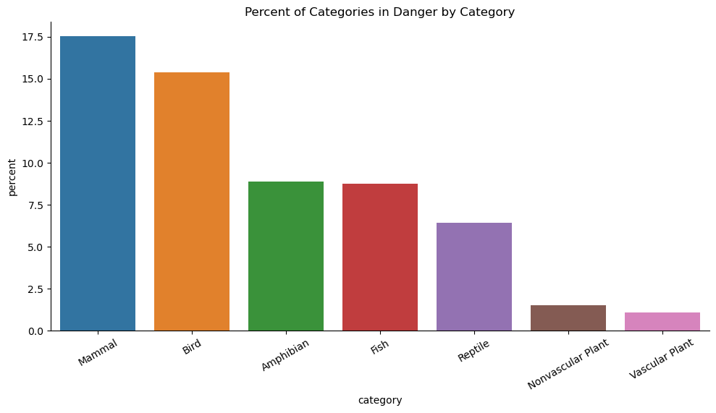
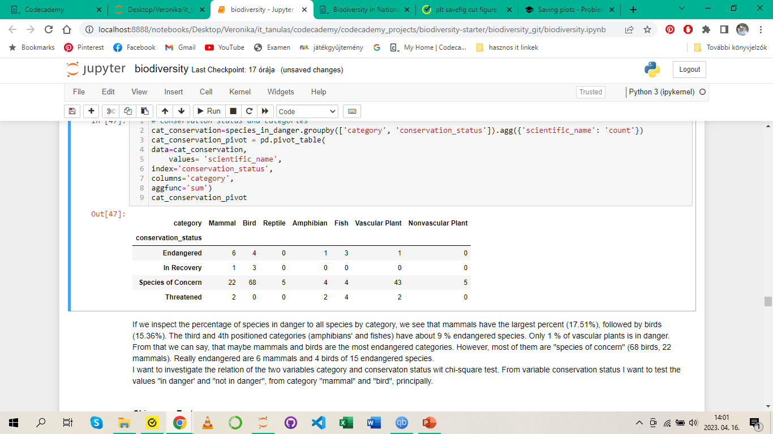
Proportion of Species in Danger to All Species

Slide 10
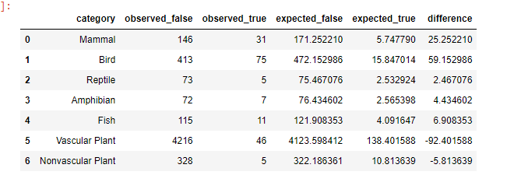
Relation of Category and Endangered Status
Method: chi-square tests
Focus: in danger – not in danger / mammals – birds
Significance treshold for p-value: 0.05
For chi2: 4

Slide 11
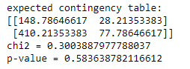
Mammal vs Bird
p-value = 0.58
much larger than the genereal significance treshold 0.05.
Chi2 = 0.3
smaller than 4
there does not seem to be a relation between birds and mammals being in danger

Slide 12
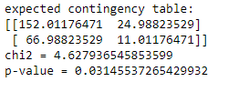
Mammal vs Reptile
p-value = 0.03
smaller than 0.05,
the chi-square value = 4.63
greater than 4
It seems to be a relation between mammal and reptile being in danger: mammal have significant greater probability of being in danger than reptile.

Slide 13
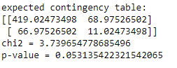
Bird vs Reptile
The p-value = 0.053
which is the significance treshold
The chi2-value =3.74
a little bit smaller than 4.
The relation between birds and reptile being in danger is maybe significant, but the relation is weak.

Slide 14
Relation of Endangered Status and Park Name
Number of Observations of Species in Danger in National Parks
Number of Observations of Species in Danger by Categories
Observations of Species in (endangered/ in danger/not in danger) Status in Parks
Observations of Common Names in National Parks

Slide 15
Number of Observations of Species in Danger in National Parks

Slide 16
Number of Observations of Species in Danger by Categories

Slide 17
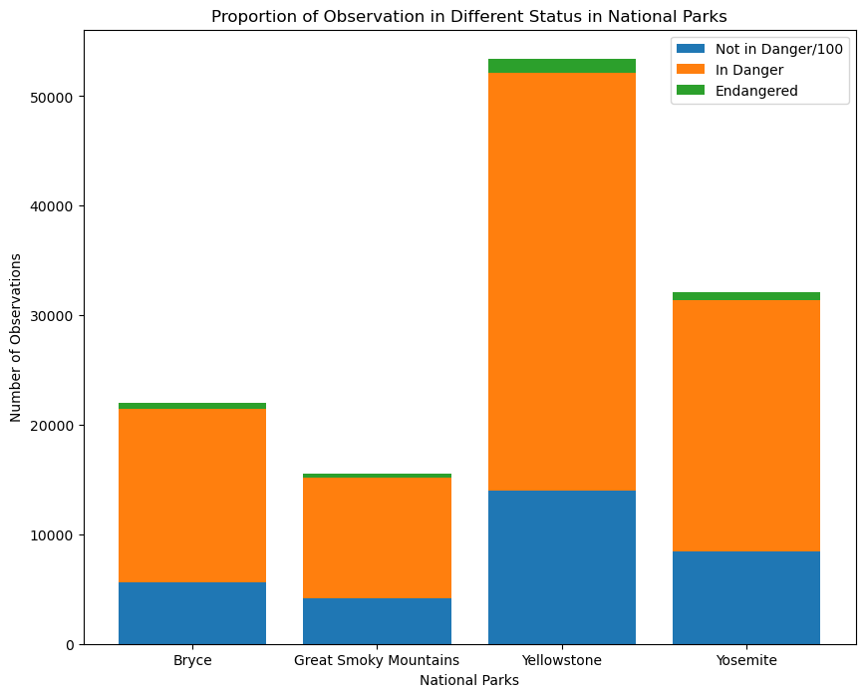
Observations of Species in (endangered/ in danger/not in danger) Status in Parks
I devided the number of all observations by 100 to show better the top of the bars where you can see the number of observation of endangered species
The number of observations are the highest in Yellostone National Park
among all observations: 43.54%
among species in danger: 43.34%)
among endangered species 43.88%
The same situation can be observed in other national parks. (Dataframe by Index).

Slide 18
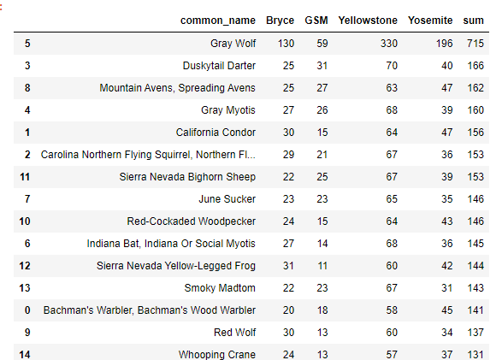
Observations of Common Names in National Parks
The observations of the Gray Wolf are in all National Parks high
The numbers are in Yellowstone National Park the highest, but proportionately they are the same for each record.
It can not be observed any relations between endangered status and national parks.

Slide 19
Methods

Slide 20
Analysis

Slide 21
Results

Slide 22
Discussion

Slide 23
Appendix

